Slide 1
Process Scheduling:
It is an activity in multiporgramming.
selecting a process based on the particular strategy.
This can be done by process scheduler.
Schedulers:
Scheduleres are special system s/w. which handles process scheduling in various ways.
Scheduling Queues:
os maintains some queues for process scheduling.
Job Queue
Ready Queue
Device Queue
Job Queue: Job queue contains list of all the processes which are present in the system. The content of the job queue stored in the secondary memory.
Ready Queue: Ready Queue contains list of processes which are ready for the execution.waiting for cpu. ready queue present in the main memory.

Slide 2
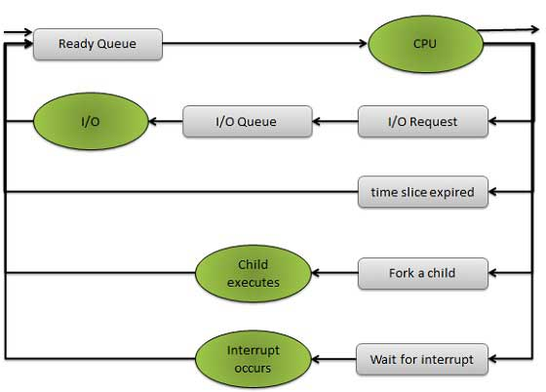
Device Queue: Device queue contains list of processes which are waiting for I/O operations
i/p:reading data from file
o/p:writing data to file.
queues are represented in rectangular box
resources ae represented in circle
arrows are represented the process flow

Slide 3
Types of schedulers:
Long Term Scheduler (job scheduler)
Short Term Scheduler (cpu scheduler)
Medium Term Scheduler
L.T.S: it loads the processes from secondary memory to main memory. in secondary memory we have job queue. which contains all the processes in the system.
S.T.S: picks process from ready queue and allocate cpu to the process. so cpu starts the execution of that process.
main difference b/w L.T.S vs S.T.S is degree of frequency.which means which schedulers are using more frequently and which scheduleres are using less frequently.
L.T.S uses less frequently and S.T.S uses more frequently.
ex: in round robin algorithem TQ=1MS. process po need to complete its execution in 15 ms.so 15 times s.t.s will use.
L.T.S controll the degree of multiporgramming. which means how many no fo processes will load from S.M to M.M.
While placing the proceses from S.M to M.M , L.T.S has to select the process that contains CPU bounded instructions and I/O bounded instructions

Slide 4
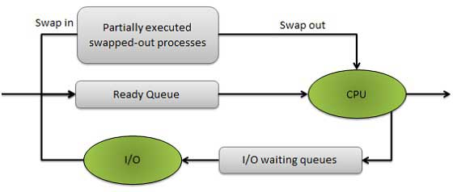
CPU bounded process: cpu instructions are more and i/o instructions are less
I/O bounded process: I/O instructions are more and cpu instructions are less
M.T.S: it is used in the implementation of swapping concept
swapping: CPU is executing the process at that time os sends an interupt to the CPU. so CPU stops the execution of the process. The partially executed process swappped out into the secondary memory. After sometime partially executed proces loaded into ready queue. i.e, called swap in.
L.T.S | S.T.S | M.T.S
it is a job scheduler | it is a cpu scheduler | it is a swapping scheduler
speed is less | speed is high | between L.T.S & S.T.S

